Slide 1
Australia Road Fatal Crashes
Adrian censon
Notes:
This is common problem among developing and developed countries like Australia
Let me tell more about this

Slide 2

World Health Organization
who is WHO?
is a specialized agency of United Nations that is concerned with international public health
It considers road fatal crashes as health community issue and recommends making it a political priority
So what is the response of Australia to WHO’s recommendation?
Notes:
The response of Australia is really good, the number of road fatalities is continue to reduce for over the years.
Tell the policies implement by Australia. Like traffic lights, helmet, seatbelt, lincesing system for young driver, bus and truck driver, speed camera 50 km/hr speed limit on residential area and more

Slide 3
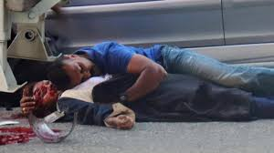

The focus of this study is twofold
to address the loss of life in traffic accidents
affect the functionality of whole cities
Notes:
- In single blink of eye life can be change for an individual, for a family and even the whole communities
- And additional to this very serious issue the loss of life affect the functionality of whole cities. At some point road accident is can cause traffic congestion and also delayed on delivery of supply goods

Slide 4

Goal
to encourage and motivate people, industries and government towards safer Australia roads

Slide 5
Can Australia continue to reduce further the number of road fatalities?
So I will predict if Australia can reduce the number of road fatalities.

Slide 6
Data Source and Cleaning
Data came from Department of Infrastructure and Regional Development.
Data is from year 1989 to 2016
Clean the data.
Check for null values.
Check for outliers.
Load in database for safe keep and retrieval.

Slide 7
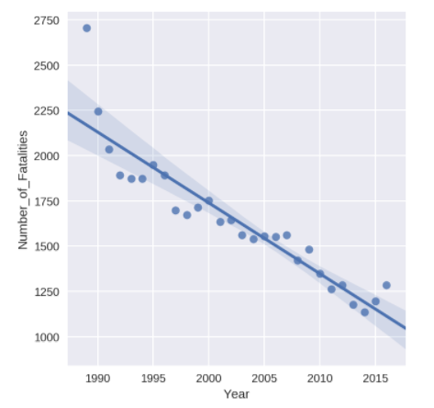
Methodology
Machine Learning (Linear regression)
Check if there are features that are correlated to each other.
I did some visualization to check the linearity in my dataset.
Identify my target variable and predictor.
Standardized the data
Run the model
Notes:
If we will look at the plot, year 2015 and 2016 number of road fatalities start to move up again, let see will this goes up or goes down

Slide 8
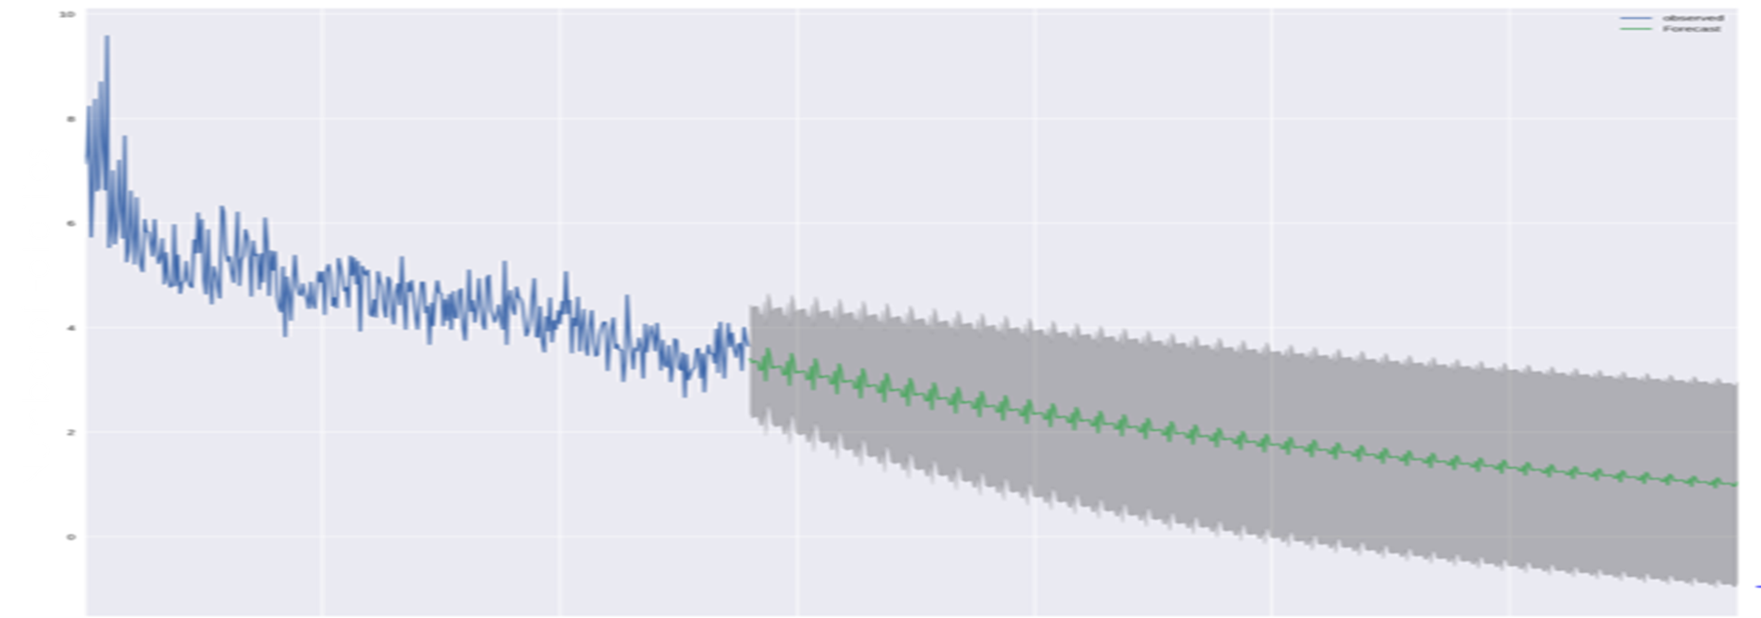
Methodology cont.
Time Series Forecasting
Use the ARIMA forecasting with Grid Search to get optimal value for prediction
Notes:
In this plot the road fatalities continue to goes down.

Slide 9
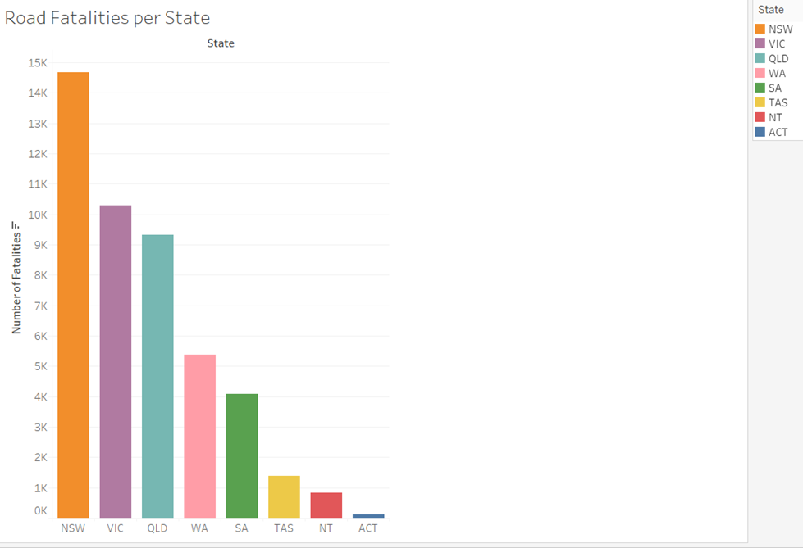
Conclusion and Findings
Time series model gave much better result, but time series is applicable only for certain time frame, the model need to maintain regularly.
NSW has the highest number of road fatalities

Slide 10
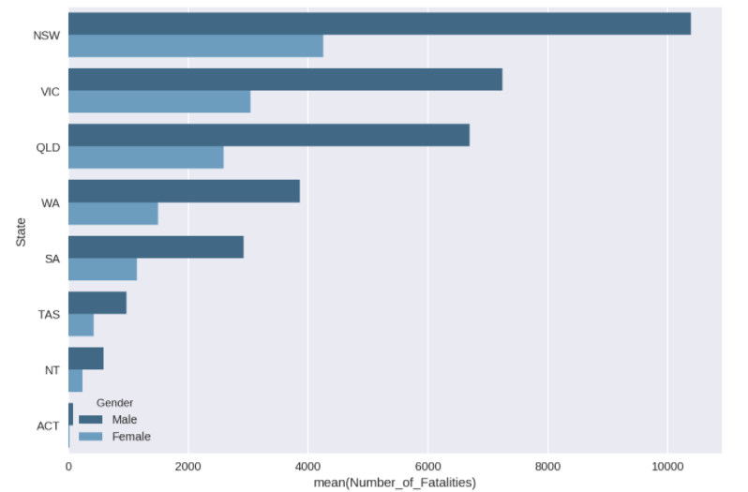
More men died in all State

Slide 11
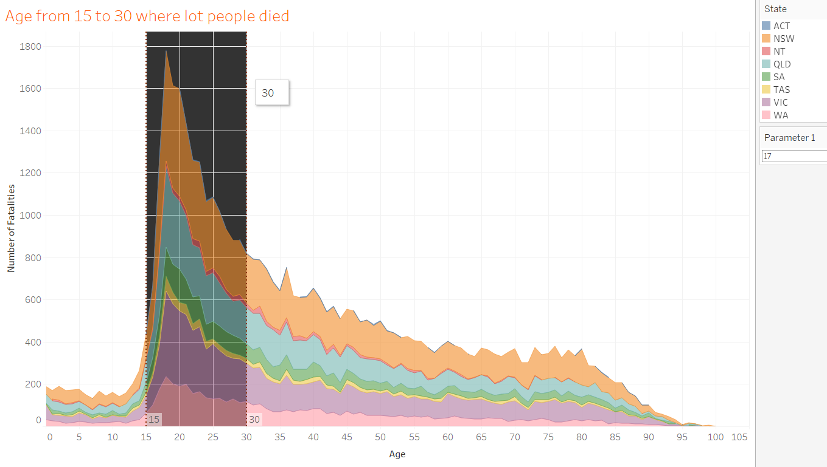
More people die at age from 15 to 30 in road crashes

Slide 12
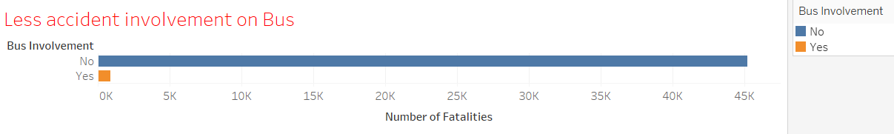
Bus is safe means of transportation

Slide 13
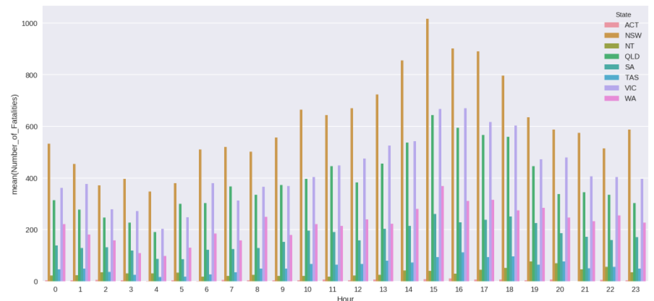
More road accidents between 2:00pm and 6:00 pm

Slide 14
Recommendations
Government and people working with them should continue to work in creating policies and initiatives to reduce the number of road fatalities.
Wide information campaign to tell bus, train or tram are safe means of transportation.
Add more jobs and business offices in different location or telecommuting might be an option.

Slide 15
Q&A:

